Slide 1

Shri Vaishnav Vidyapeeth Vishwavidyalaya
Shri Vaishnav Institute of Information Technology
AUTOMATIC SUMMARIZATION OF USER REVIEWS
Under the Supervision of:
Prof. Sujit Badodia
Prof. Manorama Chouhan
Information Technology Department
PRESENTED BY:
Piyush Mali 19100BTIT06588
Raghav Sood 19100BTIT06595
Rishika Jain 19100BTIT06604

Slide 2
AUTOMATIC SUMMARIZATION
OF USER REVIEWS
PRESENTED TO:
Prof. Jitendra Sharma
Prof. Shrikant Telang
Prof. Aruna Patidar
Information Technology Department
PRESENTED BY:
Piyush Mali 19100BTIT06588
Raghav Sood 19100BTIT06595
Rishika Jain 19100BTIT06604

Slide 3
CONTENTS
Introduction
Real Life Applications
Operating Environment
Conceptual Design
Conceptual Model
UML Diagram
Use Case Diagram
Data Flow Diagram
Activity Diagram
Class Diagram
References

Slide 4
Introduction
Aims to provide an efficient and enhanced summarization tool for the users.
It determine the reliability of a product based on the past experiences of the customers.
Model will aim to summarize all the reviews and pick only the Top 10.
We will tend to summarize the reviews posted by the users on the e-commerce giant Amazon for the mobile phones purchased by them through the website.
The dataset used will be Prompt cloud which contains approx. 4 Lakhs reviews.
Results will be analyzing based on certain metrics like Model Efficiency and Time Efficiency.
The mixed Reviews present in the dataset will first be segregated into positive and negative and then a score will be given to each of those positive and negative reviews.
The Top 10 reviews with the highest score will be presented(both negative and positive out of those).
Based on which a user will be able to make an informed decision.

Slide 5
Real life applications…
Media vigilance: To break down the never-ending stream of information into manageable chunks is provided by automatic summarization.
Newsletters: Summarization would enable businesses to add more value to newsletters by adding a stream of summaries.
Financial research: Systems designed to summarise financial documents, such as earnings reports and financial news, can speed up the process by which analysts extract market signals from content.
Social media marketing: Organizations that create lengthy content, such as e-books, and blogs, may be able to use summary to simplify their work and make it easier to share.
E-learning and class assignments: Many lecturers frame their lectures with case studies and current events. By creating a summary report, summarization can assist teachers in updating their content more rapidly.

Slide 6
Operating Environment
The rule for selecting hardware and software is that the components/application must be functionally efficient, capable of interfacing with other software, and easy to maintain.
OS: Windows 8 or later one
Processor: i3, i5 and equivalent Ryzen
Main Memory:8 GB RAM (Minimum)
Hard Disk:120 SSD or 1 TB HDD
Language: Python
Libraries: NLTK, Textblob, Vader, NumPy, Pandas, Networkx
Platform: Kaggle or Anaconda
Database: from Kaggle - Amazon Reviews: Unlocked Mobile Phones

Slide 7
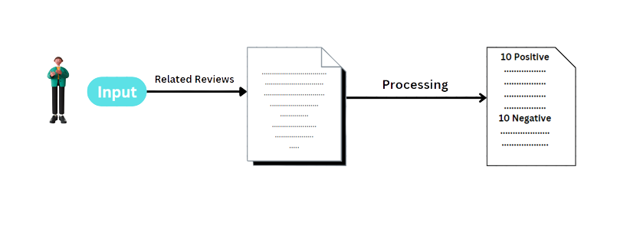
Conceptual Model

Slide 8
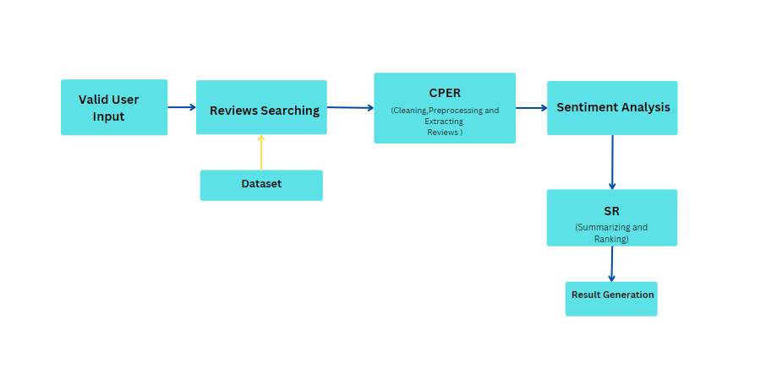

Slide 9
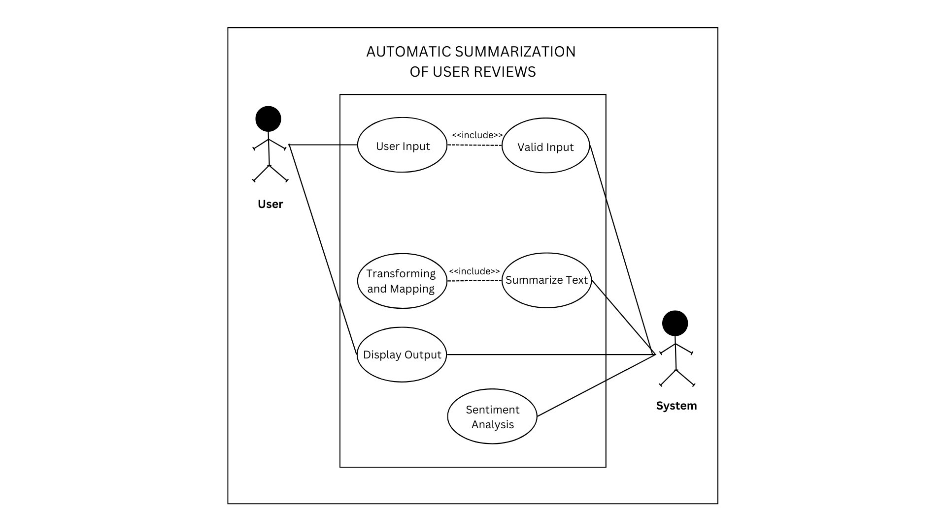
Use Case Diagram

Slide 10
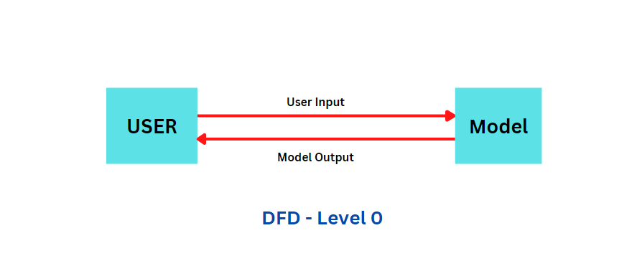
Data Flow Diagram

Slide 11
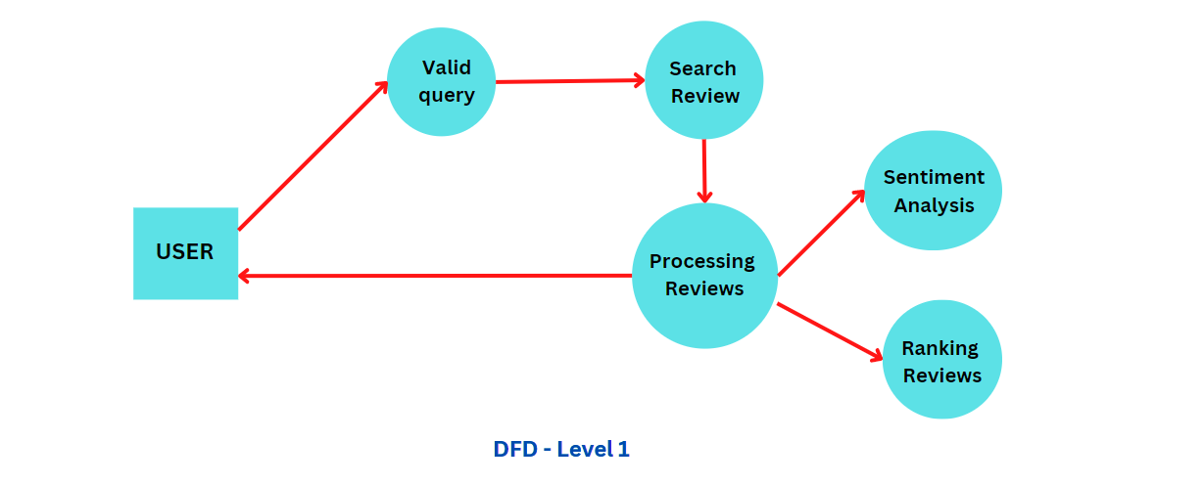
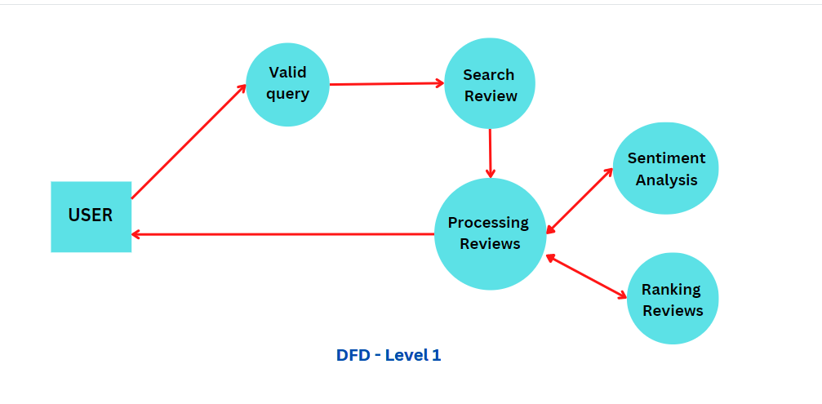

Slide 12
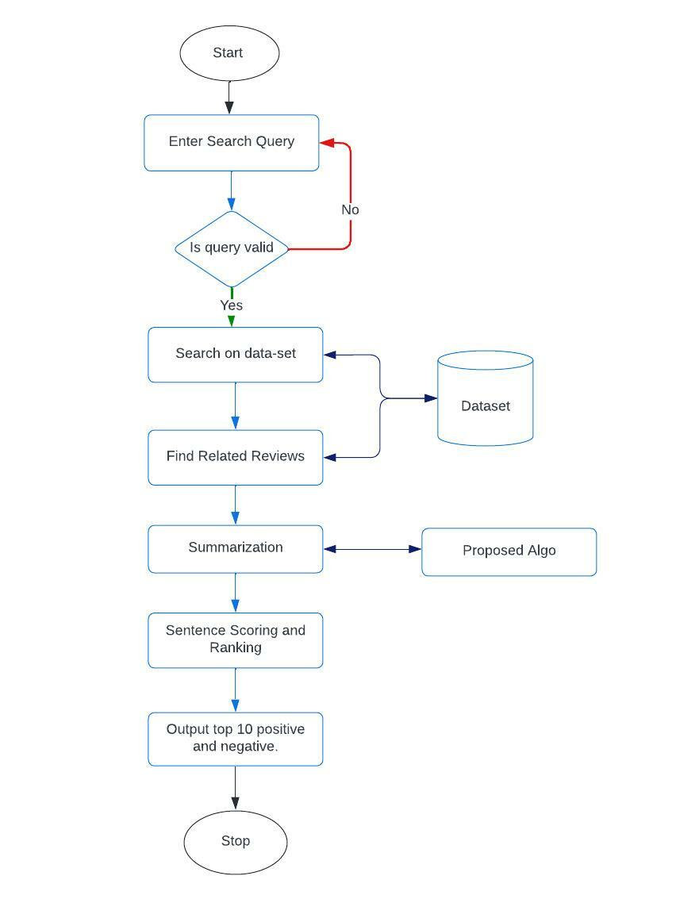
Activity Diagram

Slide 13
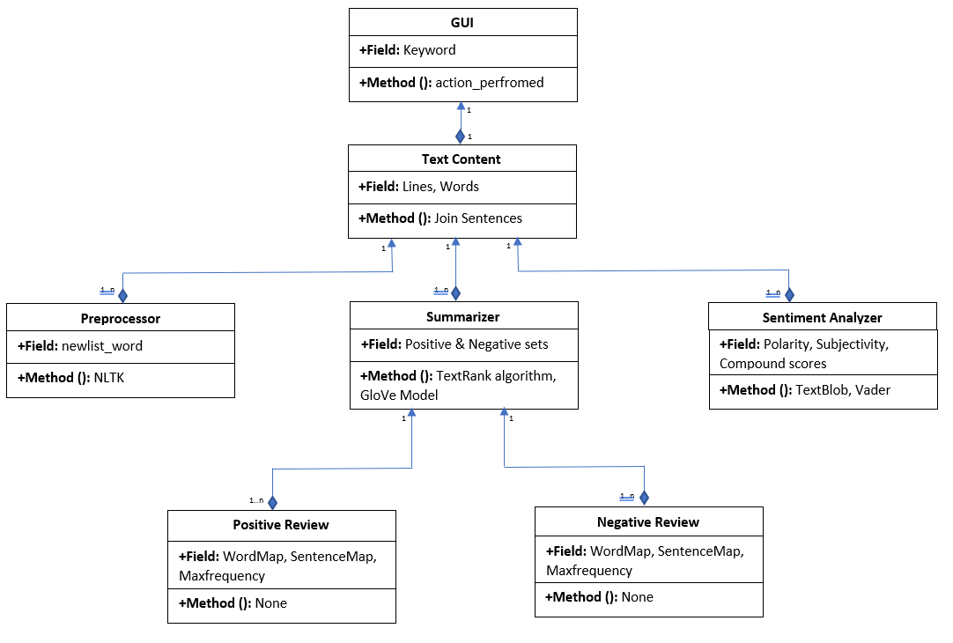
Class Diagram

Slide 14
REFERENCES
M. F. Mridha, A. A. Lima, K. Nur, S.. Das, M. Hasan and M. M. Kabir, "A Survey of Automatic Text Summarization: Progress, Process and Challenges," in IEEE CAccess, volume 9, pp. 156043-156070, 2021, doi:10.1109/ACCESS.2021.3129786. (2021)
Wafaa S. El-Kassas, Cherif R. Salama, Ahmed A. Rafea, Hoda K. Mohamed,Automatic text summarization: A comprehensive survey, Expert Systems with Applications,Volume 165,113679 ISSN 0957-4174, https://doi.org/10.1016/j.eswa.2020.113679 (2021)
Kumar, Y., Kaur, K. & Kaur, S. Study of automatic text summarization approaches in different languages. ArtifIntell Rev 54, 5897–5929 https://doi.org/10.1007/s10462-021-09964-4 (2021)
Atif, Naomie and Yogan. P ,Genetic semantic Graph Approach for multi document abstractive Summarization. Fifth International Conference on Digital Information Processing and Communications (ICDIPC)(2015).
GloVe: Global Vectors for Word Representation: Jeffrey Pennington, Richard Socher, Christopher D. Manning https://nlp.stanford.edu/projects/glove/ (2014)

Slide 15

Thank You.
ANY QUERIES?

